Slide 1
Air Quality Management
Adam Satria Adidarma
Gayuh Kautaman Rahmad

Slide 2
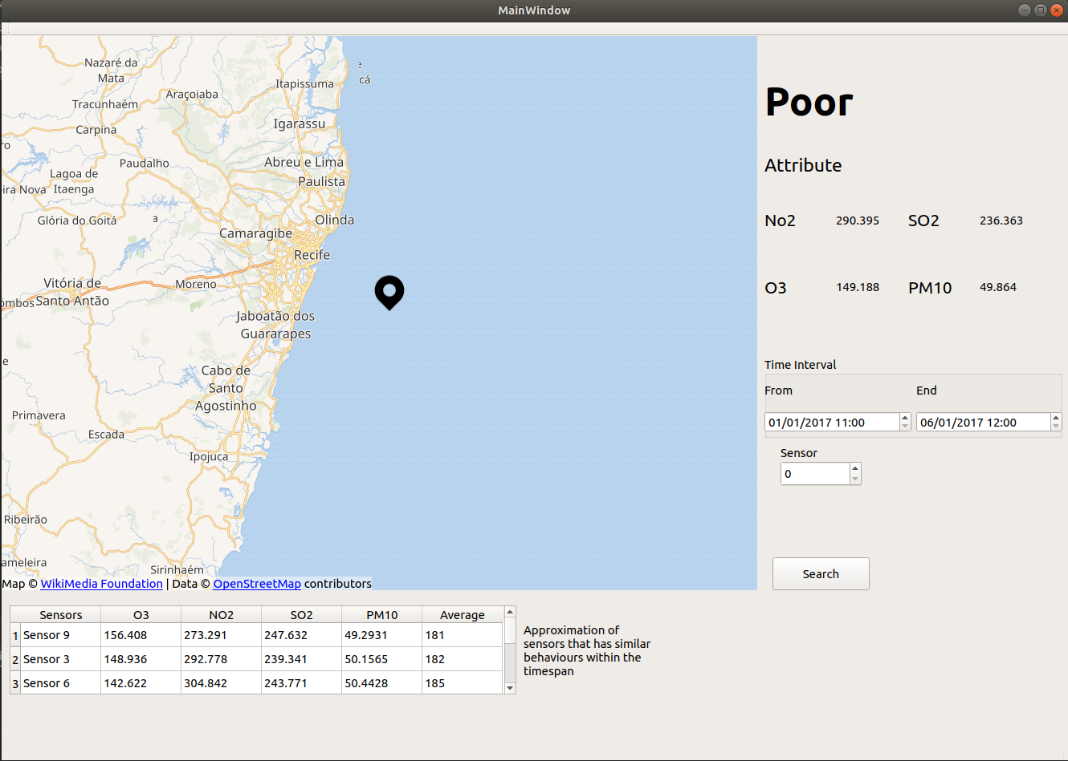
Finished Product

Slide 3
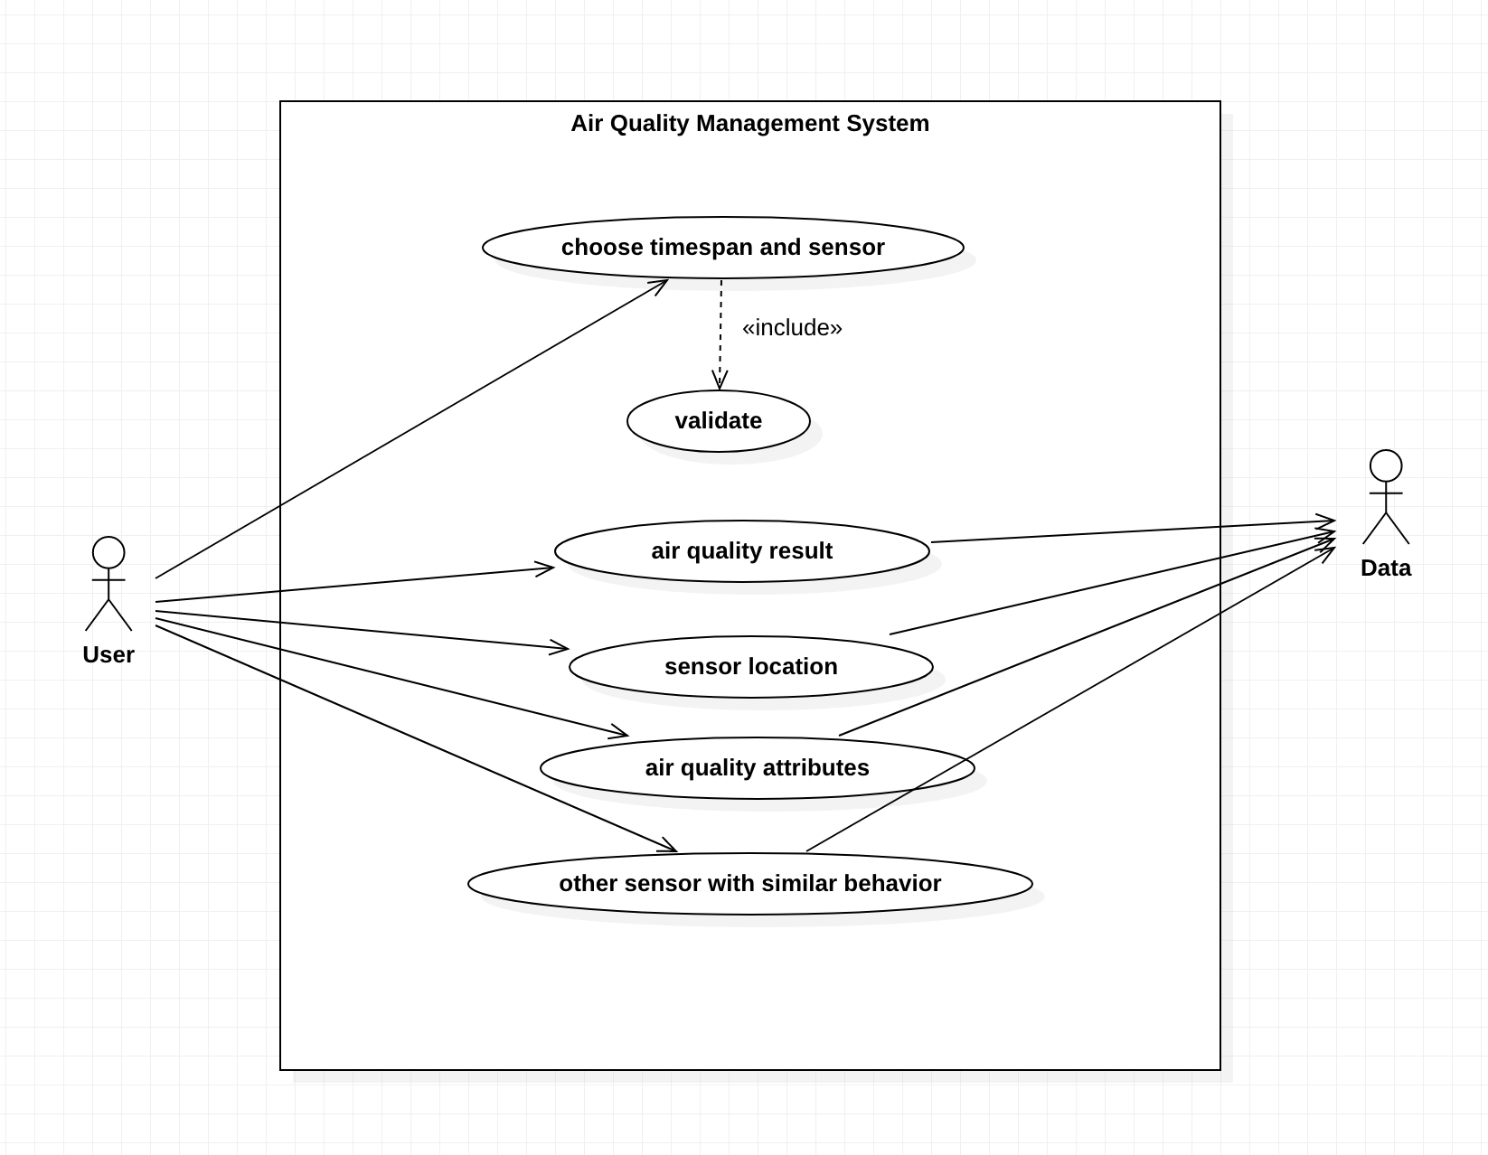
Use Case

Slide 4
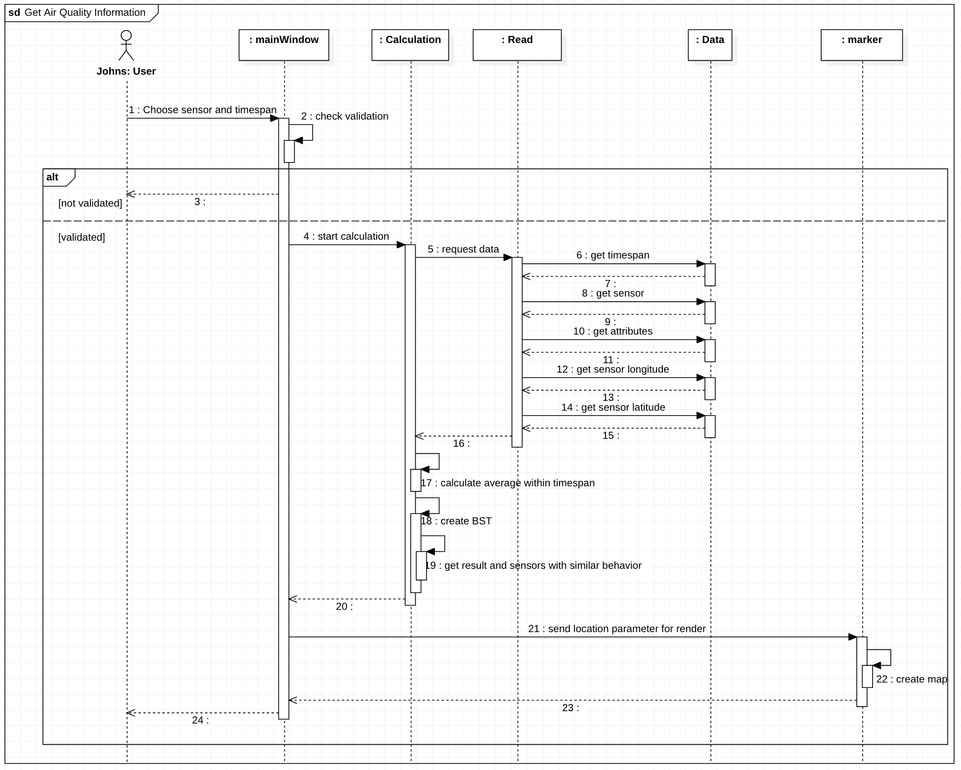
Sequence

Slide 5
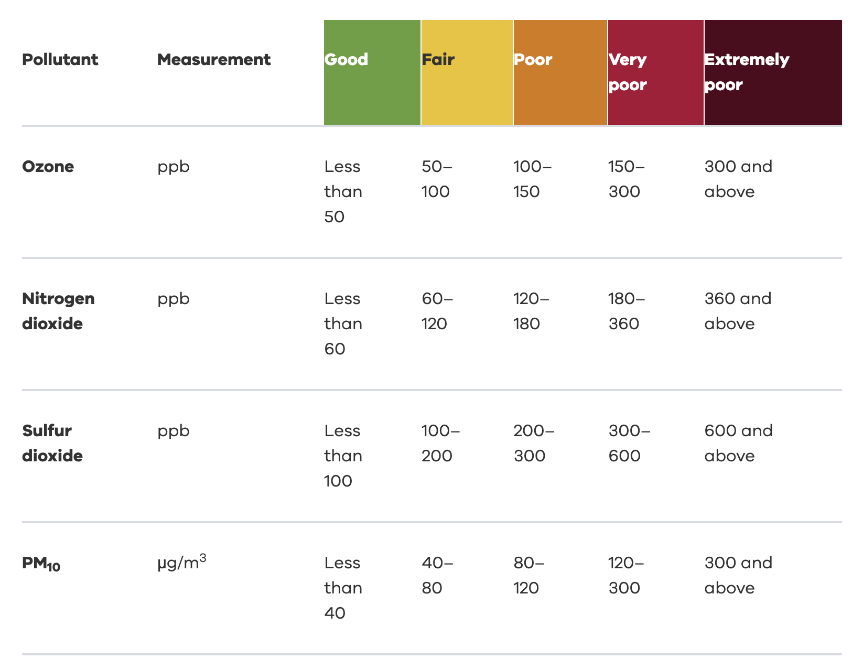
Measurement Table

Slide 6
Requirements
User Interface
Users can access this software using any machine that can run only on Linux operating system, using the mouse and keyboard as their inputs.
Hardware Interface
Since this software needs to connect to the OSM API to display map locations, all the hardware is required to have access to the internet via Modem, WAN-LAN, or Ethernet Cross-Cable.
Software Interface
The software interface of this program is developed using Qt framework with C++ programming language, and QML for map rendering.

Slide 7
Development Environment

Slide 8


Language and Frameworks

Slide 9
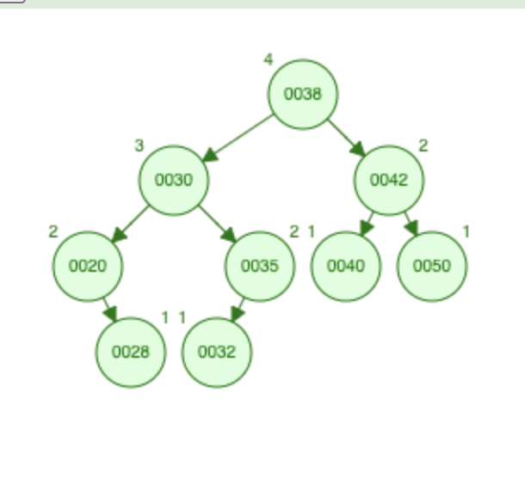
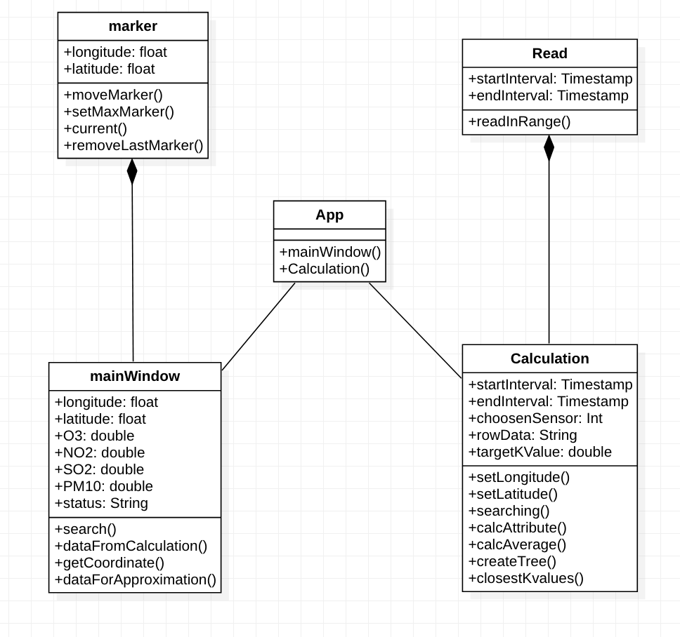
Algorithm
Read data from csv
Classify the attribute
Count average
Create tree
Find nearest value from tree
Sent to UI

Slide 10
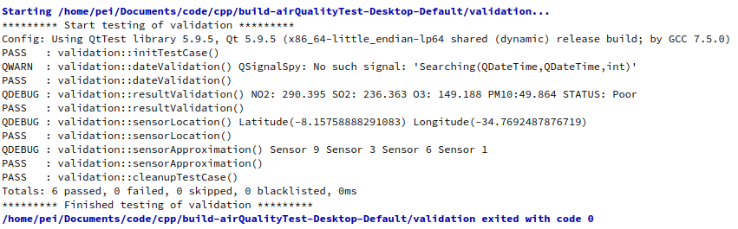
Testing

Slide 11
Thank You

